Slide 1


Leaf nitrogen is driven by the unit cost of nitrogen and water use in Texan grasslands
Evan A. Perkowski; Nicholas G. Smith

Slide 2
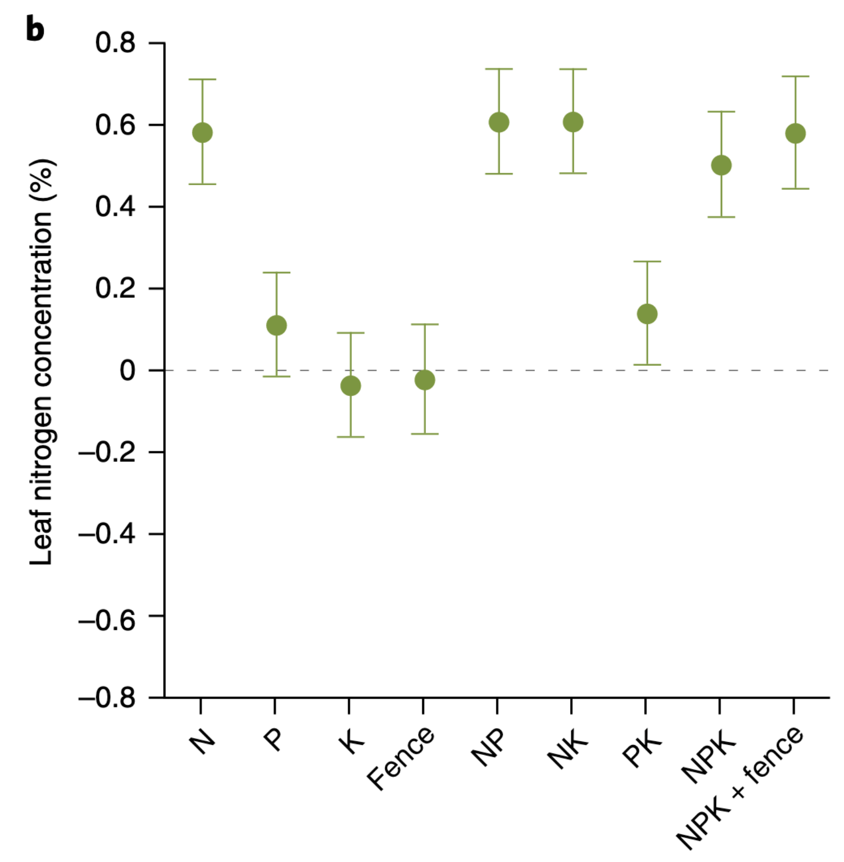
Soil nitrogen generally increases leaf nitrogen
Firn et al. (2019) Nature
Notes:
Soil nitrogen has been shown to positively influence leaf nitrogen in a fair share of studies.
This figure is from a study by Jenn Firn in 2019 using a globally coordinated nutrient addition experiment by the name Nutrient Network.
In these experiments, nitrogen, phosphorus, and potassium are added in a full-factorial field manipulation in grassland systems
On the x-axis is the different combinations of nutrient additions, and on the y-axis is leaf nitrogen concentrations

Slide 3
Soil nitrogen generally increases leaf nitrogen
Plots that receive nitrogen have higher leaf nitrogen content
Firn et al. (2019) Nature
Notes:
You can see that there is a pretty obvious increase in leaf nitrogen content in plots that receive nitrogen fertilizer regardless of potassium and phosphorus combinations

Slide 4
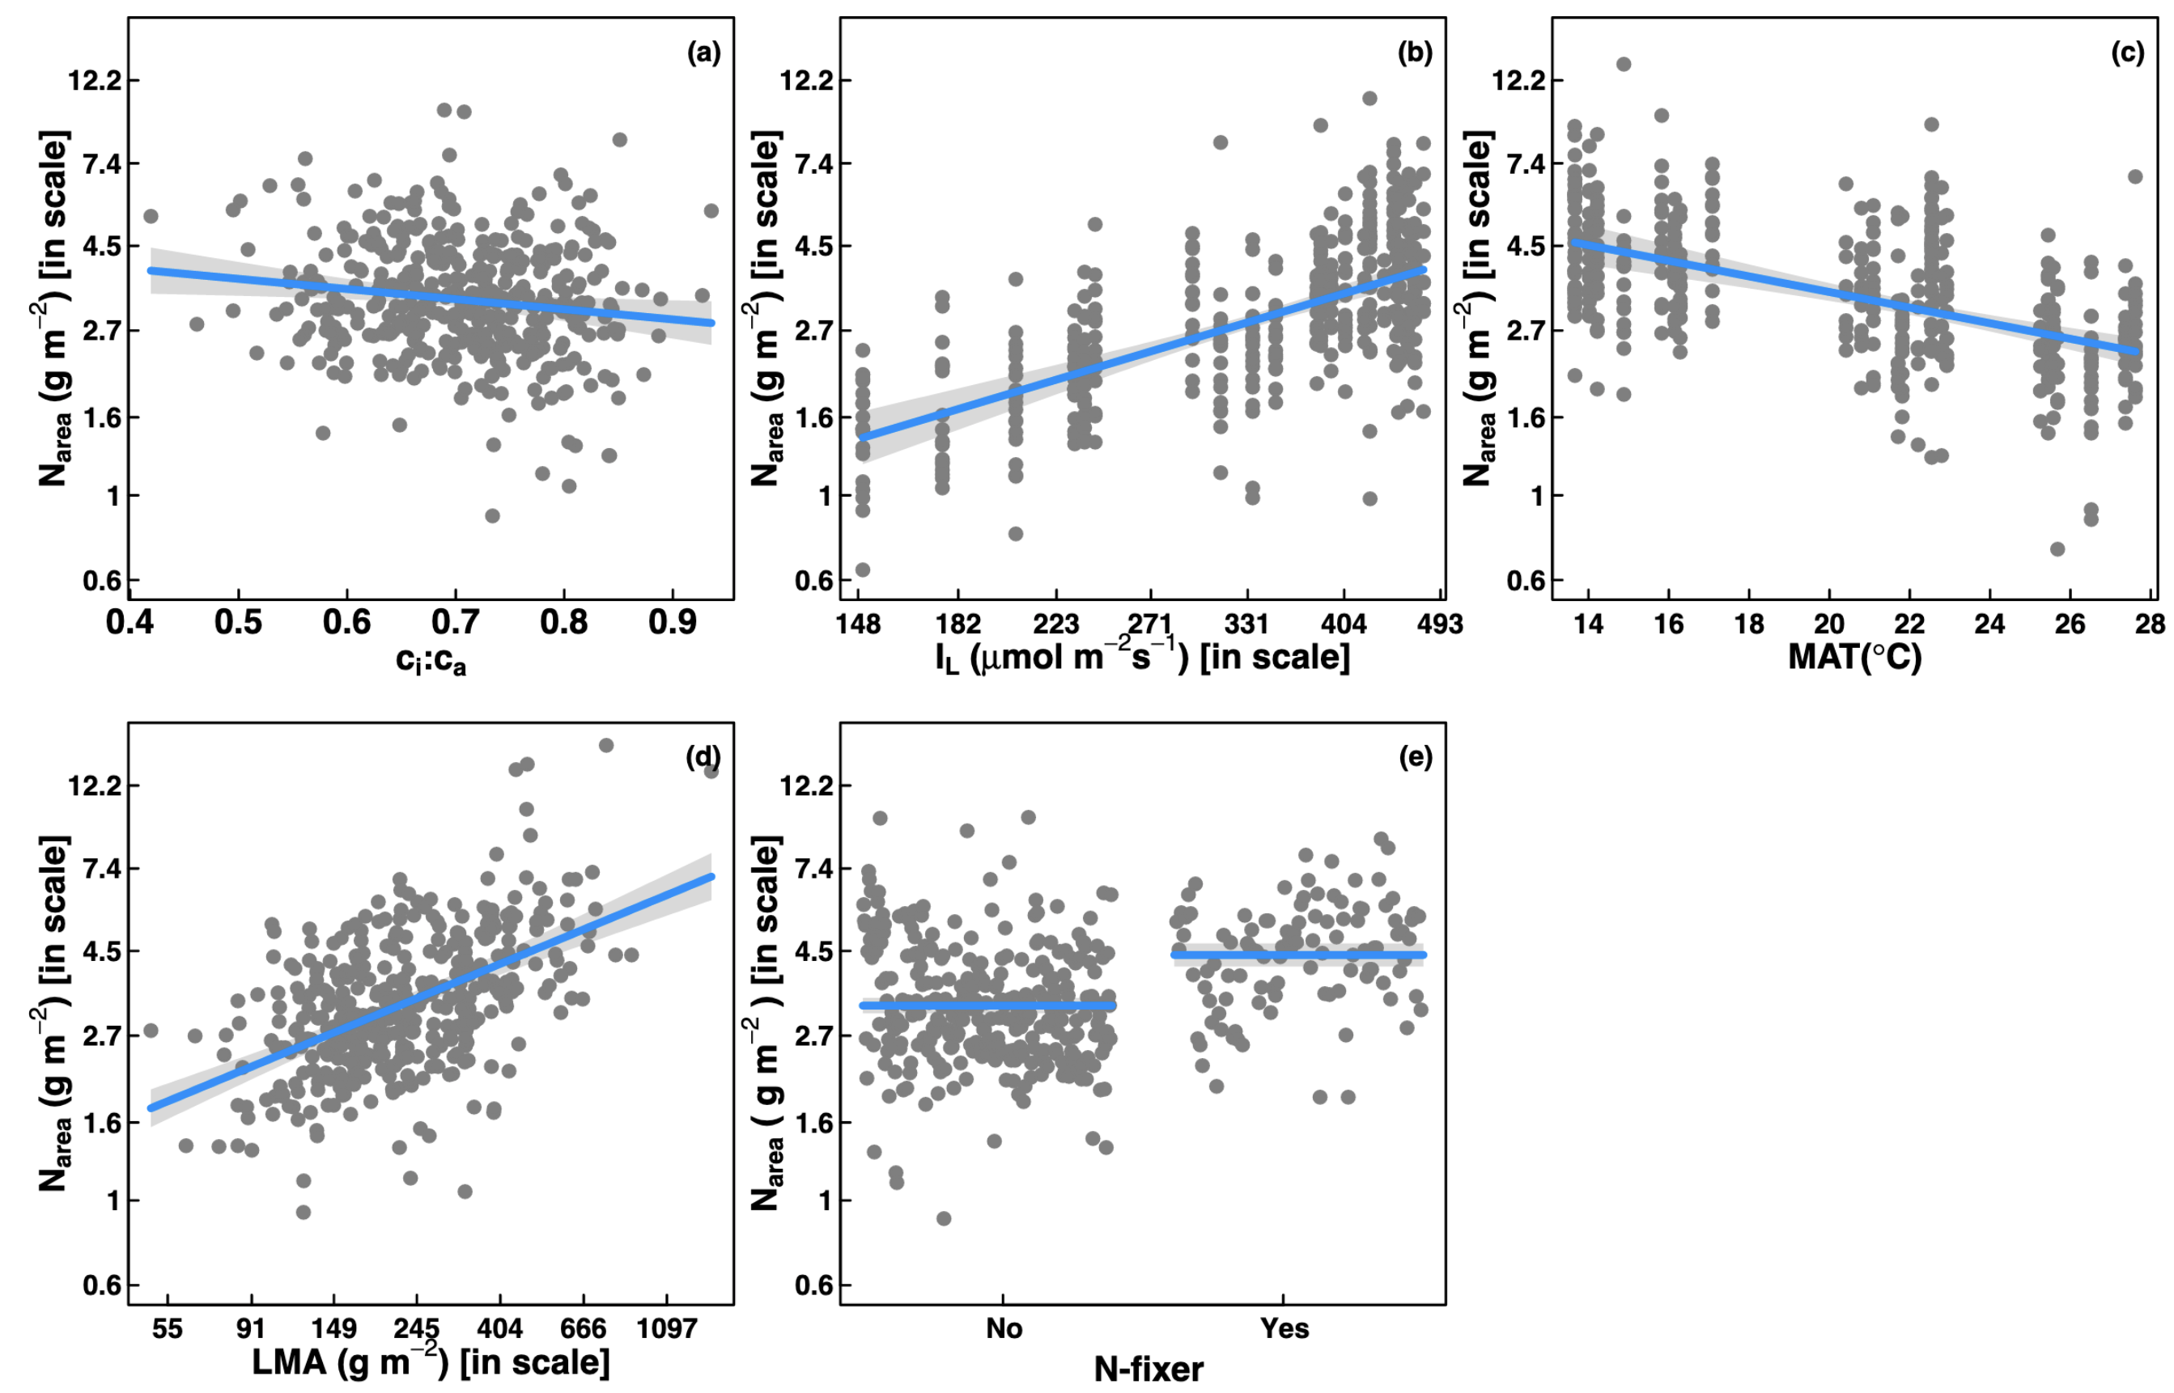
… but leaf nitrogen can be predicted independent of soil nitrogen
Dong et al. (2017) Biogeosciences
Notes:
Some recent work has also shown that leaf nitrogen can be predicted independent of soil nitrogen availability
This is work from Ning Dong showing on the top row in panel b and c that leaf nitrogen can be predicted from photosynthetically active radiation, which is basically light, and mean annual temperature.
Additionally, they show in panel a that leaf nitrogen can be predicted by the ratio of intercellular carbon dioxide to extracellular carbon dioxide, or Ci:Ca,
In panel d, they show that leaf nitrogen can be predicted through the ratio of intercellular carbon dioxide to atmospheric carbon dioxide, and in panel e show that leaf nitrogen can be predicted on the basis of whether a species can associate with nitrogen-fixing bacteria
Thus, aboveground climate and leaf traits can be used to predict patterns of leaf nitrogen

Slide 5
Leaf N is likely a product of interactions between climatic and edaphic factors
Notes:
While we know that variation in leaf nitrogen can be explained by soil nitrogen availability, climate, or plant traits, we still do not have a firm grasp of what drives leaf nitrogen content.
It is possible that these patterns are driven by plant allocation responses to soil nitrogen and climate, but we lack data that links these responses to physiological processes that range from the leaf to whole plant level
Yet, we do not fully understand when and where soil nitrogen impacts nitrogen allocation to leaf tissue vs. other tissues

Slide 6
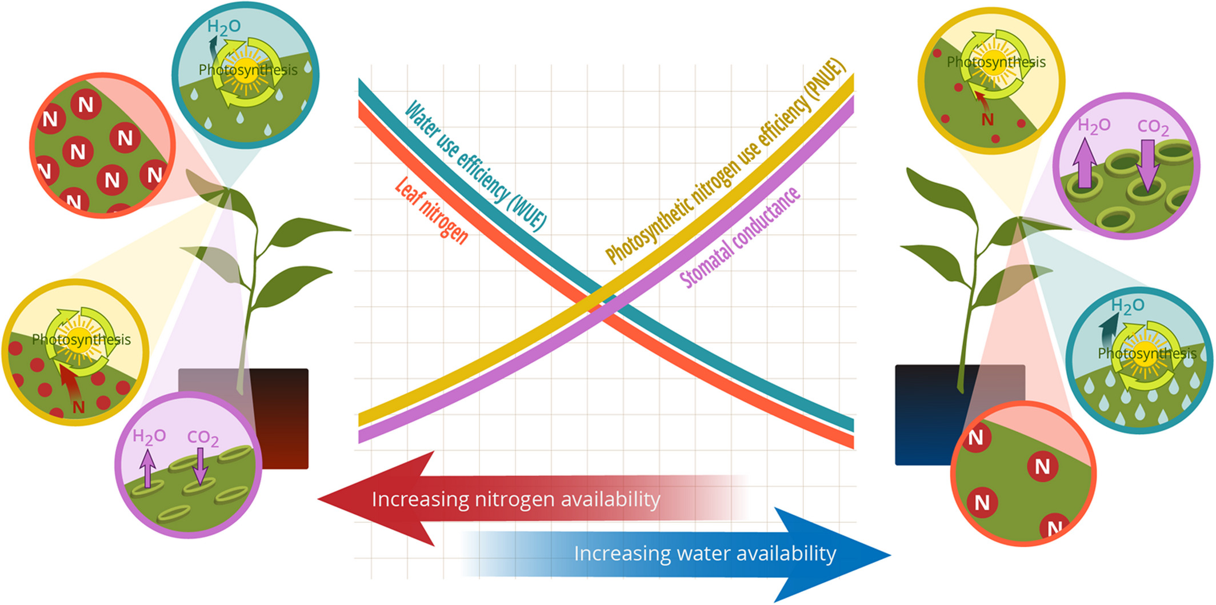
Photosynthetic ‘least-cost’ theory: leaves acclimate to changing climatic and edaphic environments via summed cost of resource use (nitrogen and water)
Bialic-Murphy et al. (2021) Ecology Letters
Notes:
At the leaf level, plants might allocate nitrogen to photosynthetic leaf tissue in order to preserve water
This option can be explained through recent frameworks suggesting that plants can and should maximize photosynthetic carbon gain by trading inefficient use of an abundant resource for efficiency a more limited limiting resource.
For example, if nitrogen is relatively more available than water, then plants can maintain a similar photosynthetic output by increasing nitrogen allocation toward photosynthetic leaf tissue in order to increase water-use efficiency., effectively employing a water-savings mechanism
We might expect these patterns would be observed in arid systems where water is relatively less available than nitrogen, although these patterns haven’t necessarily been tested in temperate regions

Slide 7
Photosynthetic ‘least-cost’ theory: leaves acclimate to changing climatic and edaphic environments via summed cost of resource use (nitrogen and water)
Bialic-Murphy et al. (2021) Ecology Letters
Notes:
At the leaf level, plants might allocate nitrogen to photosynthetic leaf tissue in order to preserve water
This option can be explained through recent frameworks suggesting that plants can and should maximize photosynthetic carbon gain by trading inefficient use of an abundant resource for efficiency a more limited limiting resource.
For example, if nitrogen is relatively more available than water, then plants can maintain a similar photosynthetic output by increasing nitrogen allocation toward photosynthetic leaf tissue in order to increase water-use efficiency., effectively employing a water-savings mechanism
We might expect these patterns would be observed in arid systems where water is relatively less available than nitrogen, although these patterns haven’t necessarily been tested in temperate regions

Slide 8
Soil N should decrease, and soil moisture should increase the cost of acquiring nitrogen relative to water
Positive effect
Negative effect
Soil resource availability
H₂O
Cost to acquire nitrogen relative to water
N

Slide 9
Increasing costs of acquiring nitrogen relative to water should decrease water use efficiency
Positive effect
Negative effect
Soil resource availability
H₂O
Cost to acquire nitrogen relative to water
Water use efficiency
N

Slide 10
Positive effect
Increasing water use efficiency should decrease leaf N
Negative effect
Soil resource availability
H₂O
Cost to acquire nitrogen relative to water
Water use efficiency
Leaf nitrogen
N

Slide 11
However, leaf N could be independent of water use efficiency...
Positive effect
Negative effect
Soil resource availability
H₂O
Cost to acquire nitrogen relative to water
Water use efficiency
Leaf nitrogen
N

Slide 12
... and may be independent of the cost to acquire nitrogen relative to water
Positive effect
Negative effect
Soil resource availability
H₂O
Cost to acquire nitrogen relative to water
Water use efficiency
Leaf nitrogen
N
N

Slide 13
Study sites, collection methods, traits
24 sites
12 in 2020
15 in 2021 (3 same from 2020)
3 leaves of 5 most dominant species at each site
Leaf N
Leaf water use efficiency (δ¹³C)
Composite soil sample
[NO₃-N]

Slide 14
Positive effect
Negative effect
Soil resource availability
H₂O
Cost to acquire nitrogen relative to water
Water use efficiency
Leaf nitrogen
N
N

Slide 15
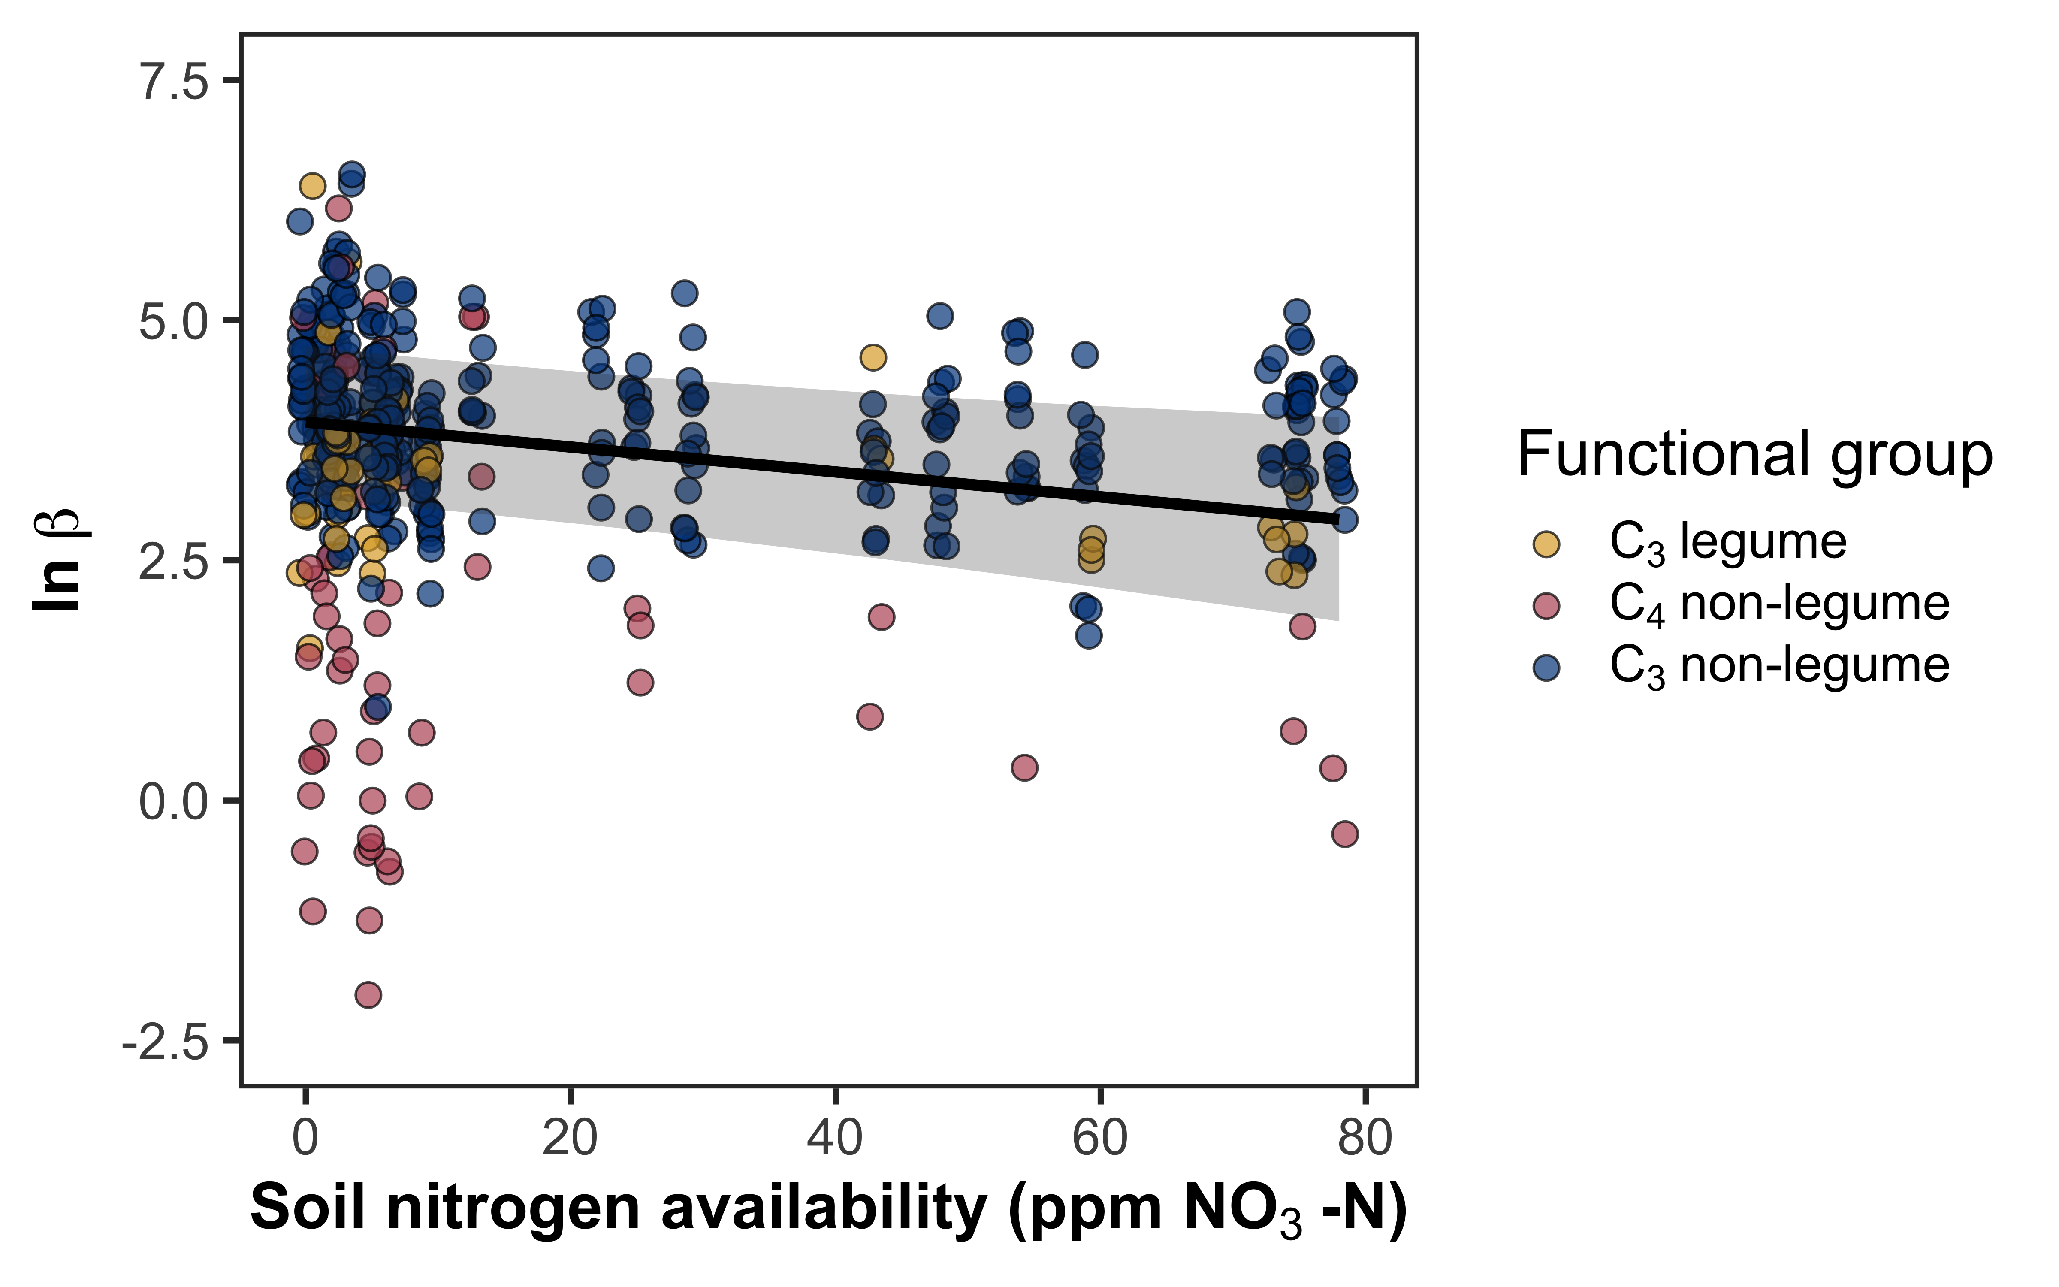
Soil nitrogen availability decreases the cost of acquiring nitrogen relative to water
Cost of acquiring nitrogen relative to water

Slide 16
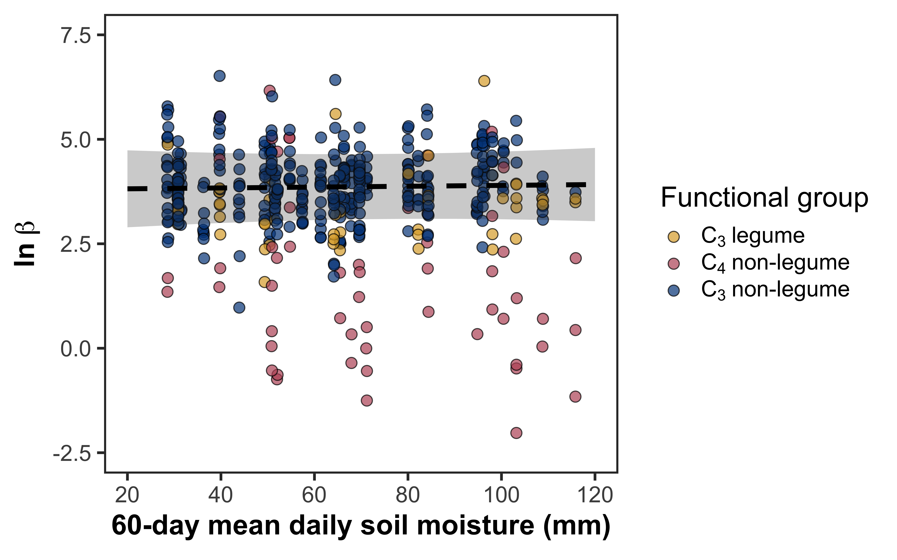
Soil moisture does not change the cost of acquiring nitrogen relative to water
Cost of acquiring nitrogen relative to water

Slide 17
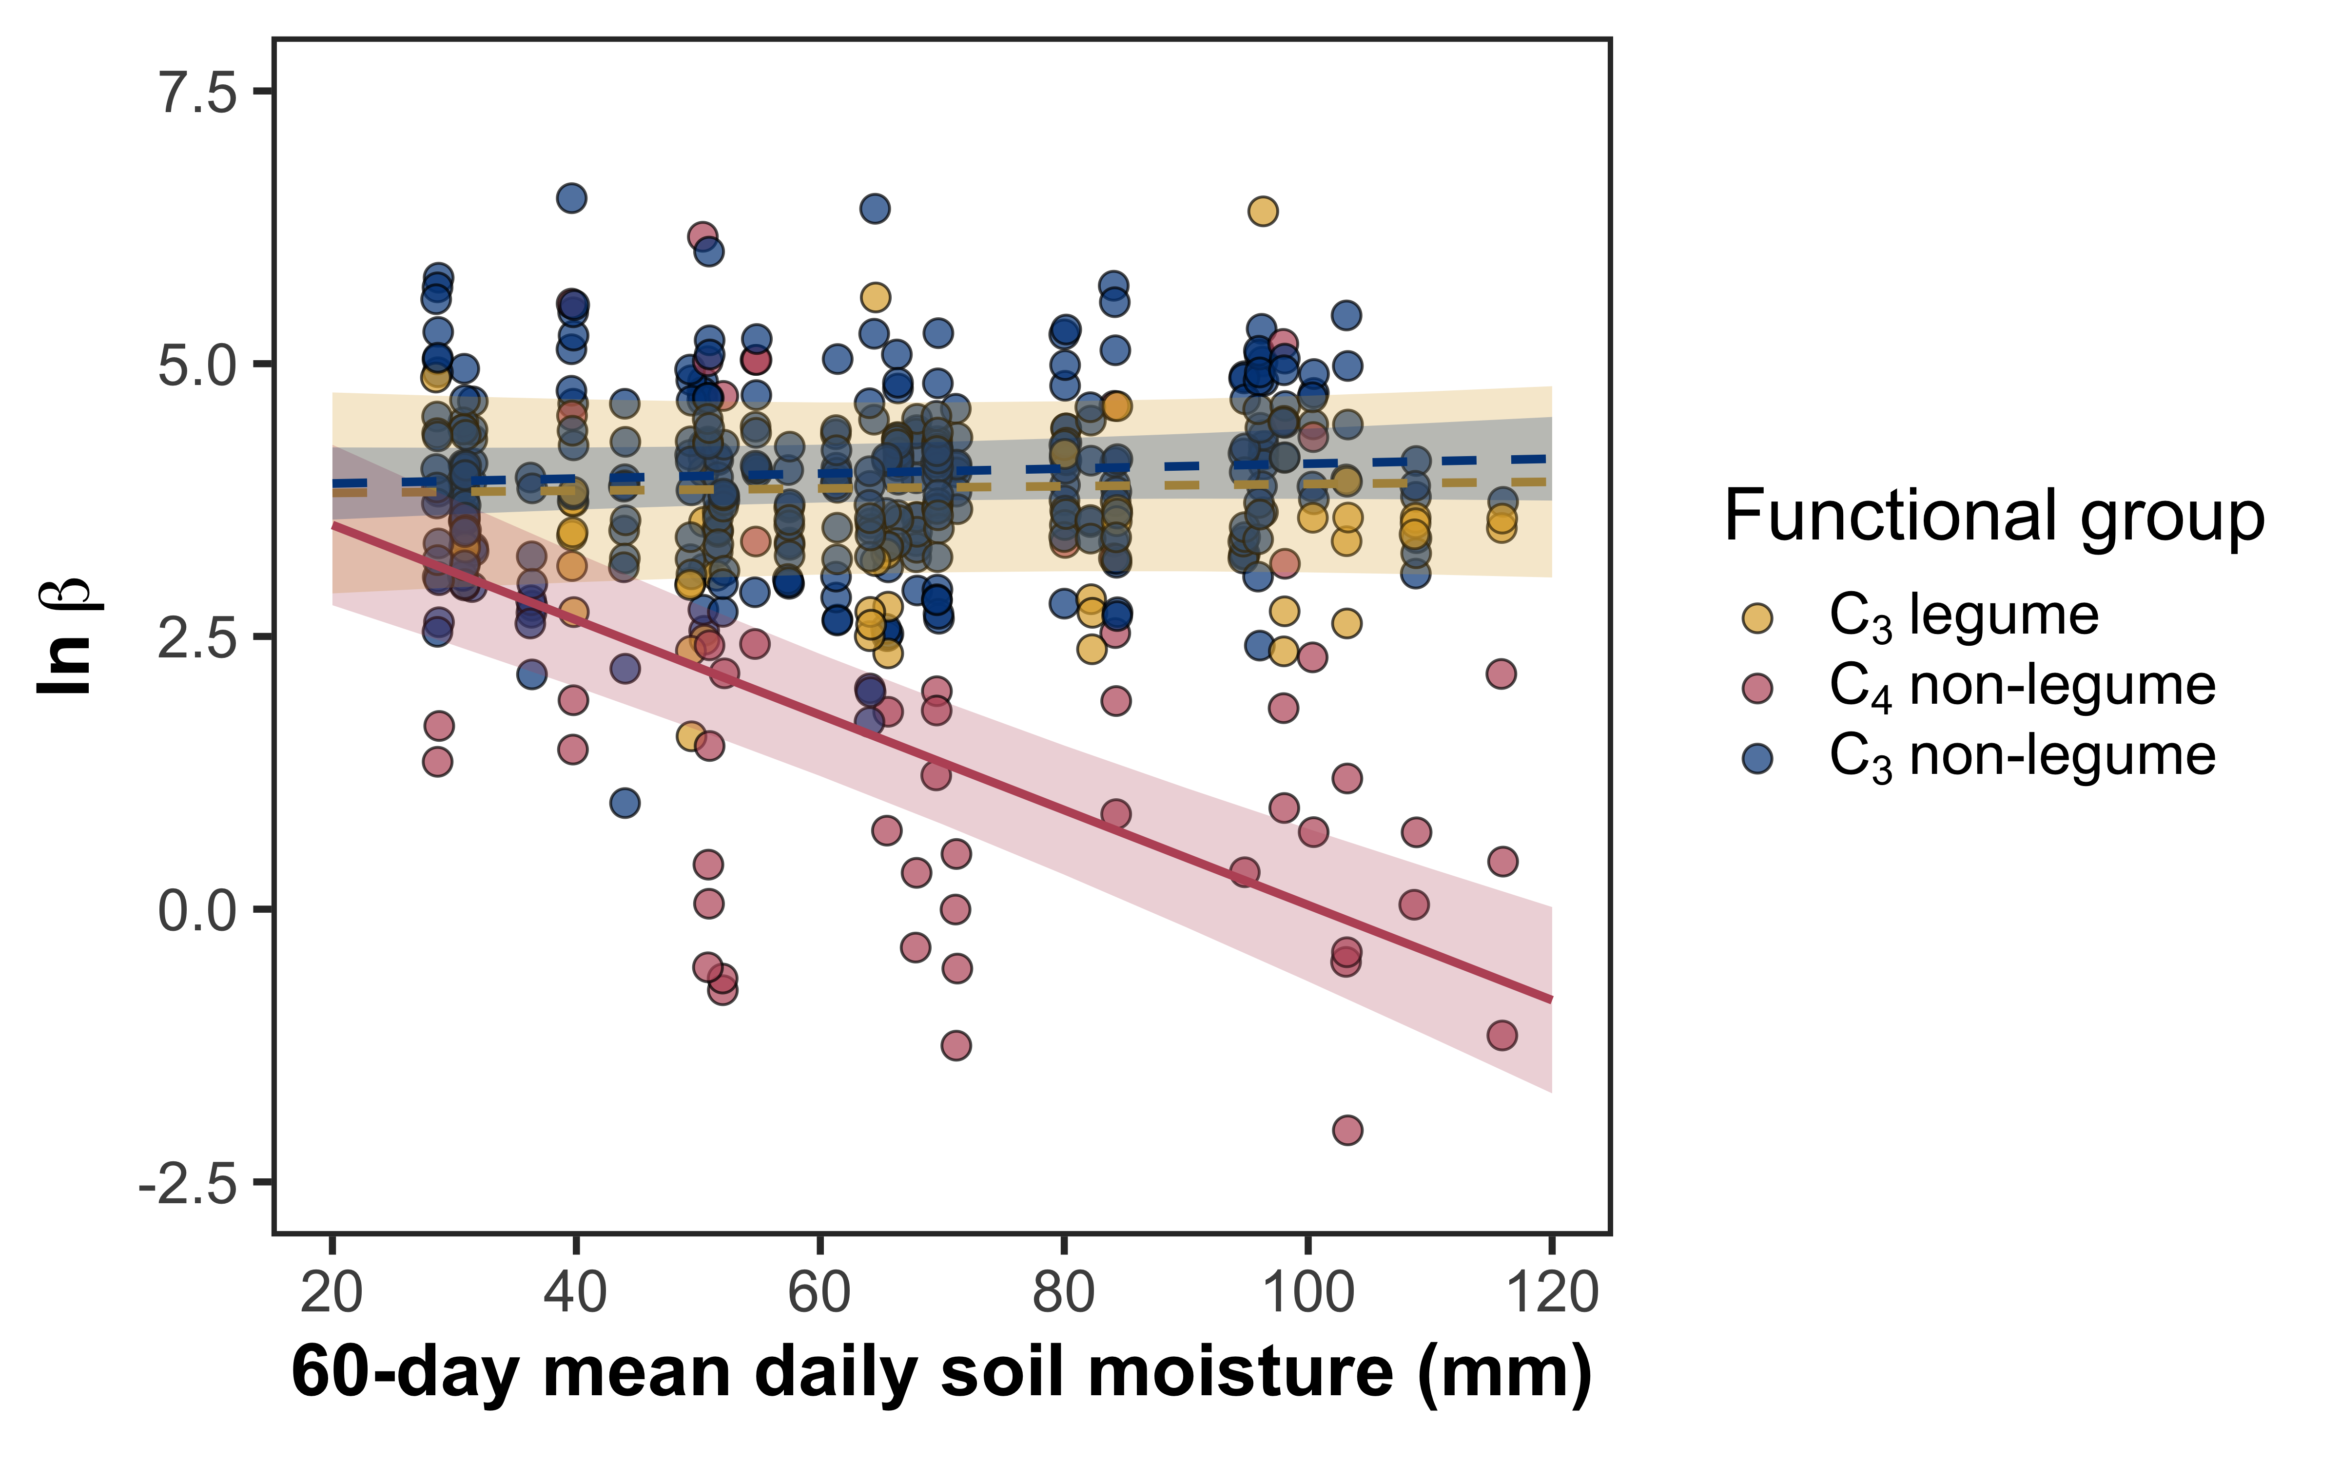
... although C₄ non-legumes experience a reduction in these relative costs with increasing soil moisture
Cost of acquiring nitrogen relative to water

Slide 18
Positive effect
Negative effect
Soil resource availability
H₂O
Net cost of resource acquisition
Water use efficiency
Leaf nitrogen
N
N

Slide 19
Positive effect
Negative effect
Soil resource availability
H₂O
Net cost of resource acquisition
Water use efficiency
Leaf nitrogen
N
N

Slide 20
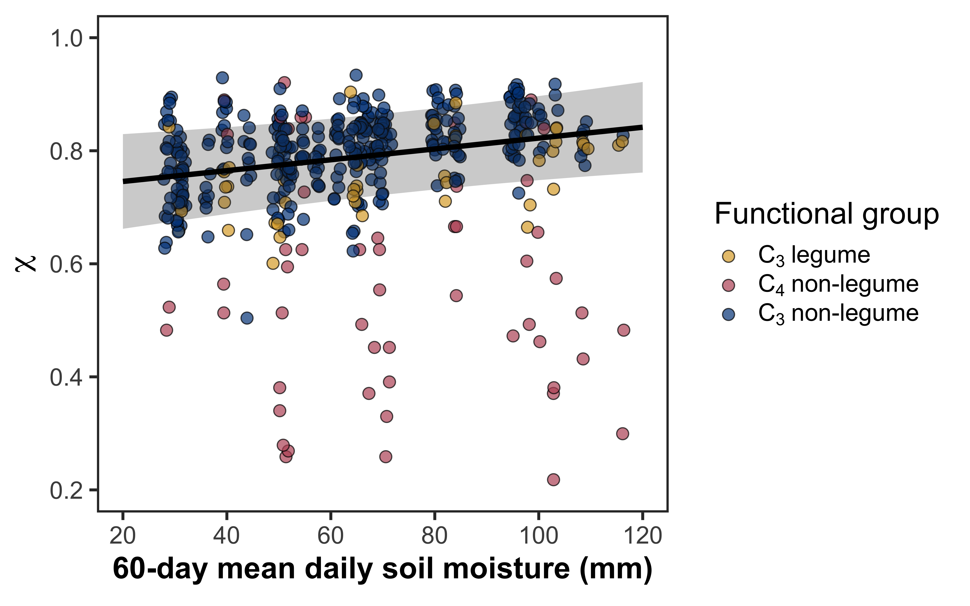
Soil moisture decreases water use efficiency

Slide 21
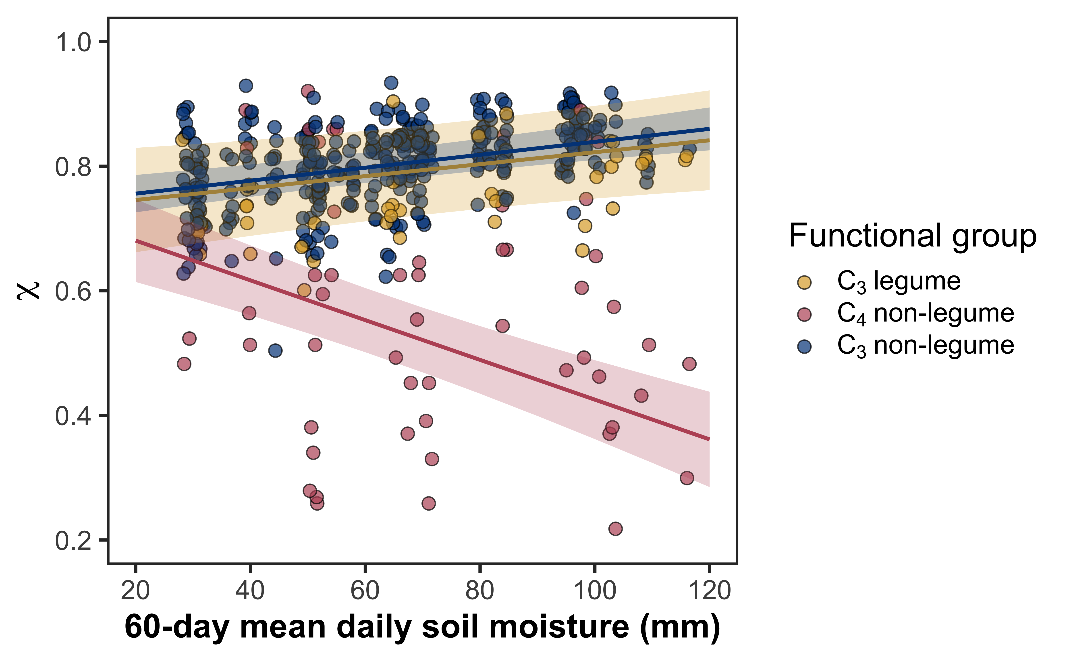
Soil moisture decreases water use efficiency, a pattern observed only in C₃ species

Slide 22
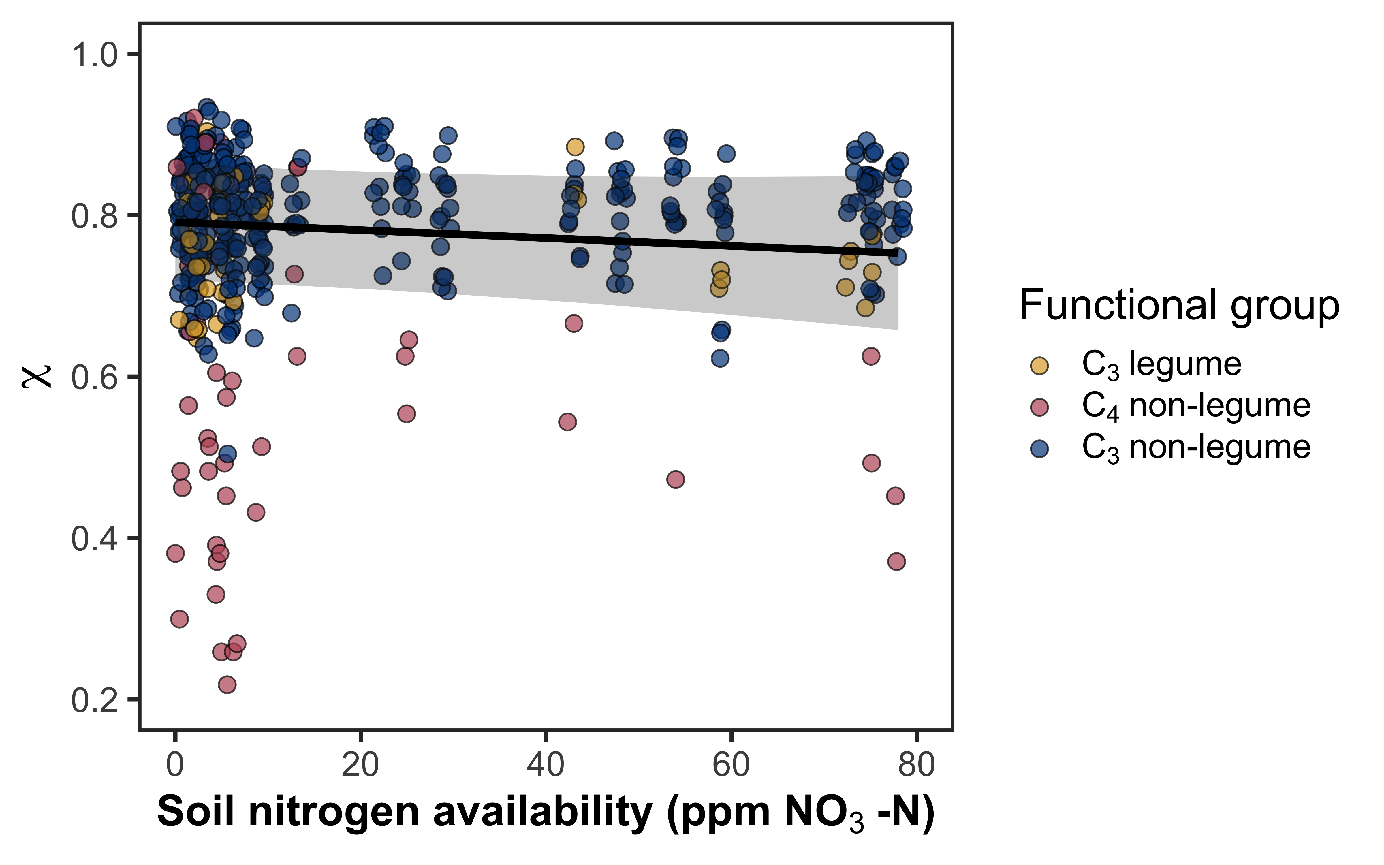
Soil nitrogen availability increases water use efficiency

Slide 23
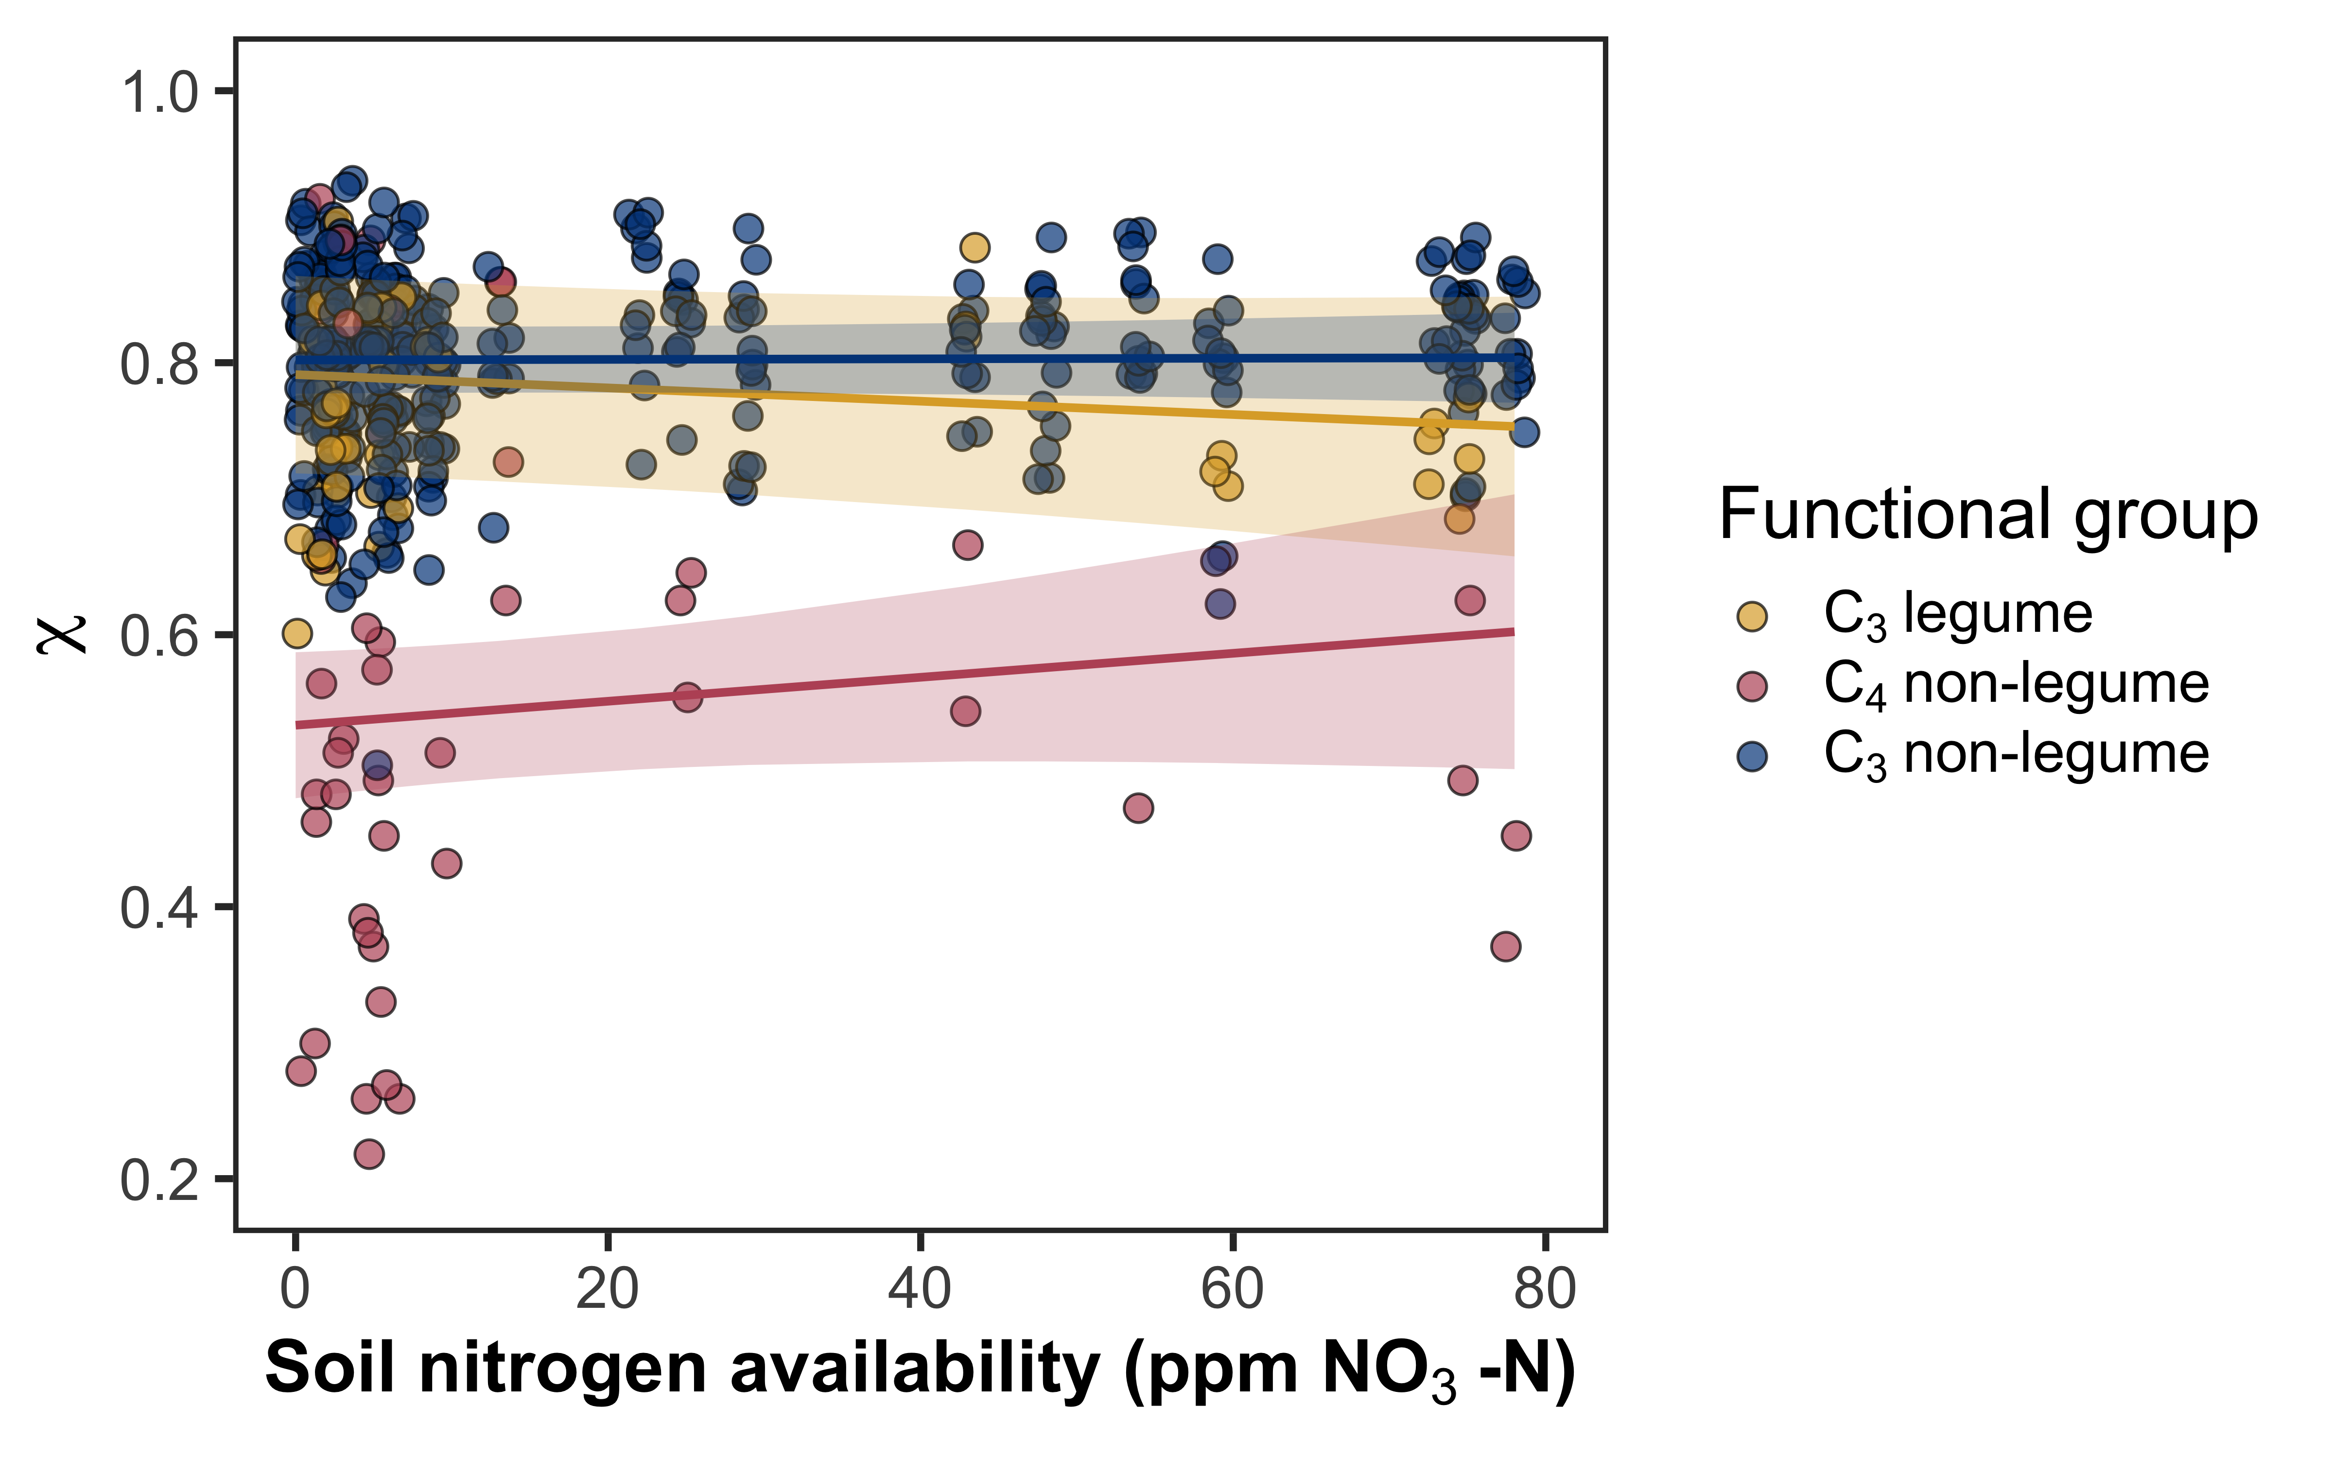
Soil nitrogen availability increases water use efficiency, but only in in non-legumes

Slide 24
Positive effect
Negative effect
Soil resource availability
H₂O
Net cost of resource acquisition
Water use efficiency
Leaf nitrogen
N
N

Slide 25
Positive effect
Negative effect
Soil resource availability
H₂O
Net cost of resource acquisition
Water use efficiency
Leaf nitrogen
N
N

Slide 26
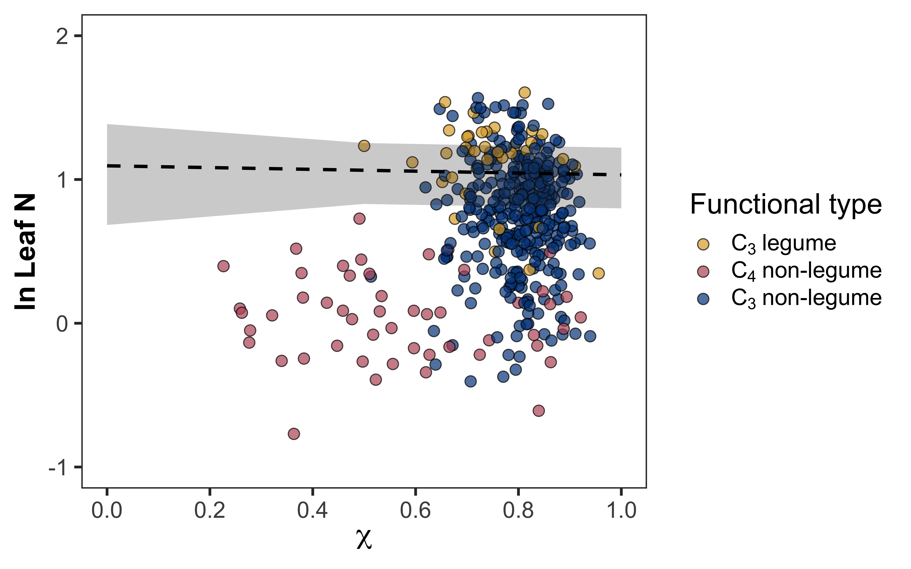
Water use efficiency does not change leaf nitrogen

Slide 27
Positive effect
Negative effect
Soil resource availability
H₂O
Net cost of resource acquisition
Water use efficiency
Leaf nitrogen
N
N

Slide 28
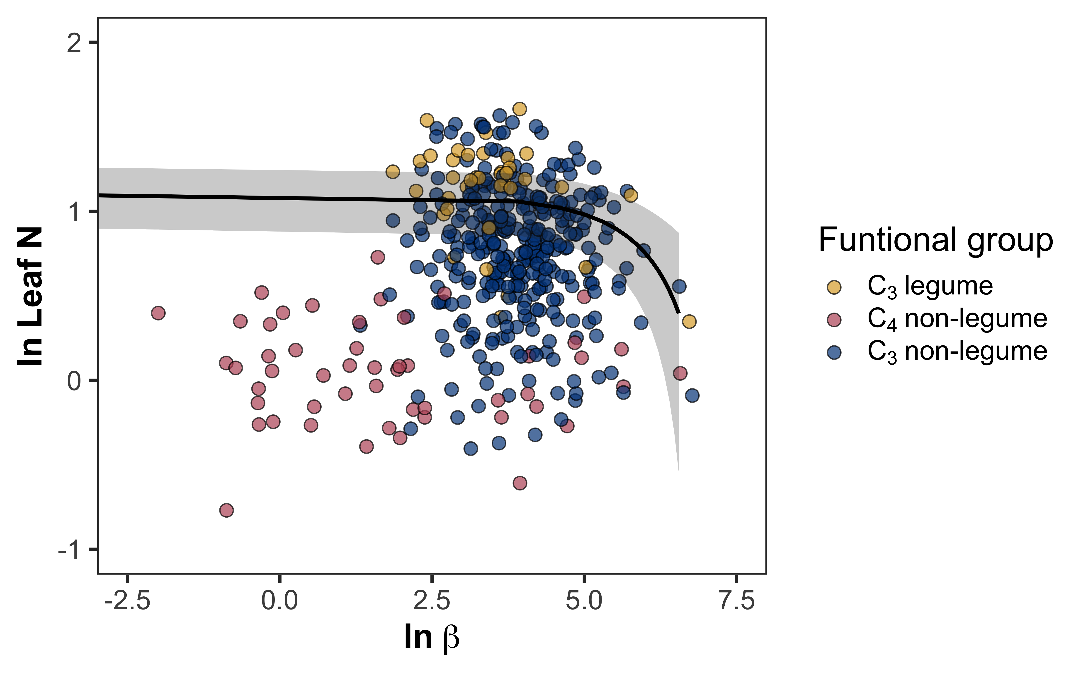
The cost to acquire nitrogen relative to water has a nonlinear, but overall negative effect on leaf nitrogen

Slide 29
Positive effect
Negative effect
Soil resource availability
H₂O
Net cost of resource acquisition
Water use efficiency
Leaf nitrogen
N
N

Slide 30
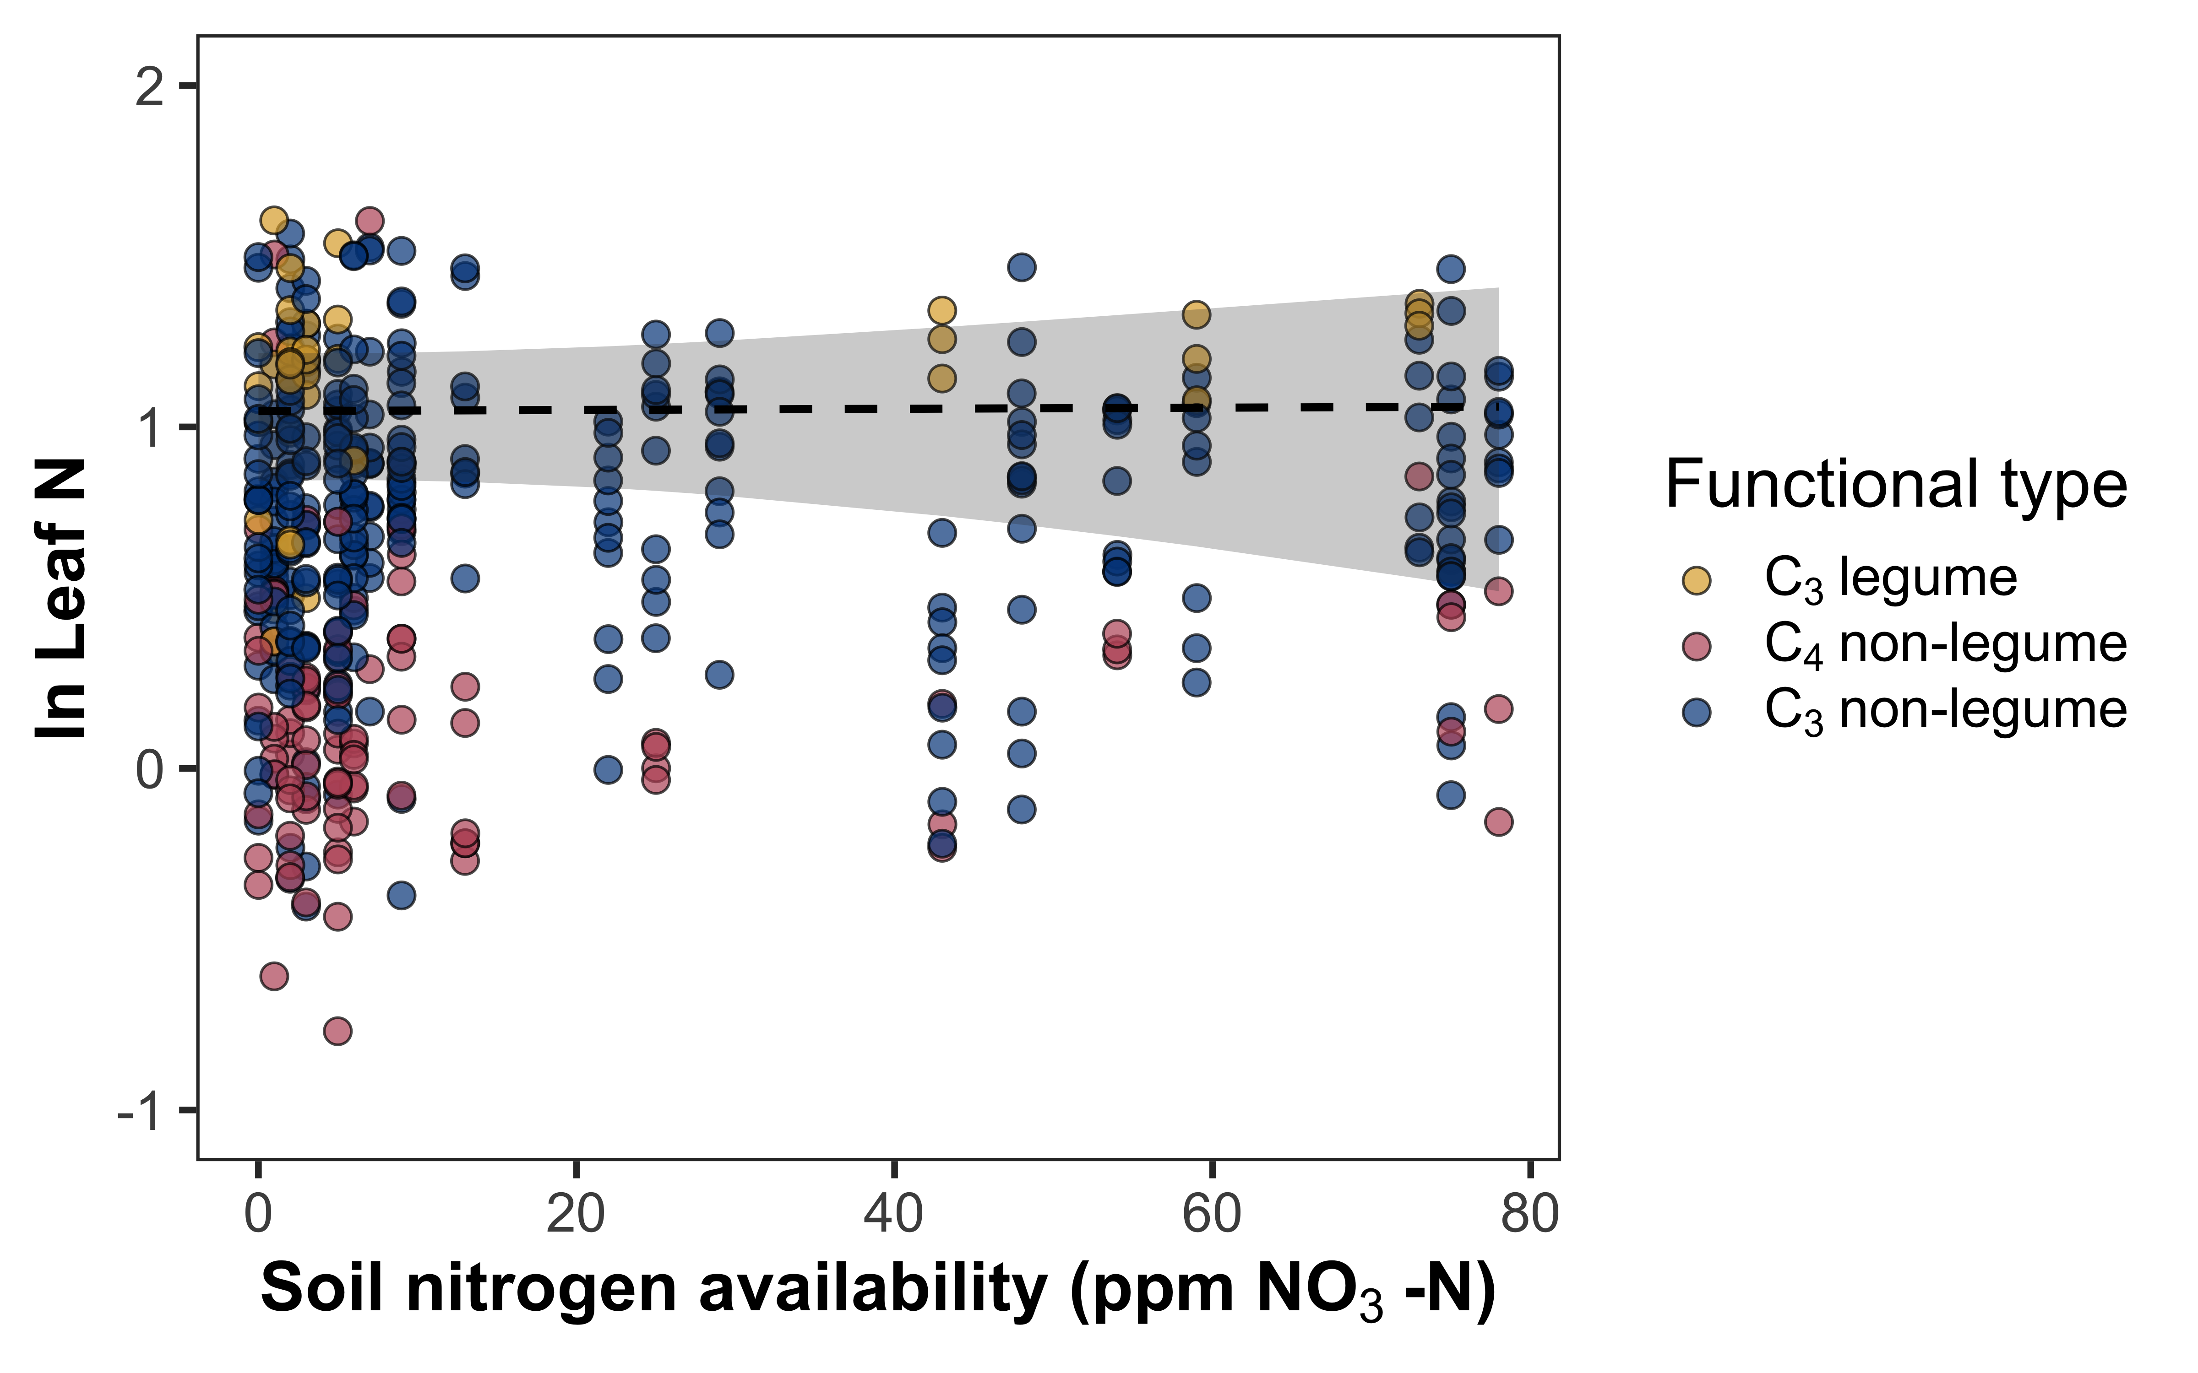
Soil nitrogen availability does not change leaf nitrogen

Slide 31
Revisiting hypotheses
Positive effect
Negative effect
Soil resource availability
H₂O
Cost to acquire nitrogen relative to water
Water use efficiency
Leaf nitrogen
N
N

Slide 32
Revisiting hypotheses
Positive effect
Negative effect
Soil resource availability
H₂O
Cost to acquire nitrogen relative to water
Water use efficiency
Leaf nitrogen
N
N

Slide 33
Revisiting hypotheses
Positive effect
Negative effect
Soil resource availability
H₂O
Cost to acquire nitrogen relative to water
Water use efficiency
Leaf nitrogen
N
N

Slide 34
Revisiting hypotheses
Positive effect
Negative effect
Soil resource availability
H₂O
Cost to acquire nitrogen relative to water
Water use efficiency
Leaf nitrogen
N
N

Slide 35
Revisiting hypotheses
Positive effect
Negative effect
Soil resource availability
H₂O
Cost to acquire nitrogen relative to water
Water use efficiency
Leaf nitrogen
N
N

Slide 36
Revisiting hypotheses
Positive effect
Negative effect
Soil resource availability
H₂O
Cost to acquire nitrogen relative to water
Water use efficiency
Leaf nitrogen
N
N

Slide 37
Revisiting hypotheses
Positive effect
Negative effect
Soil resource availability
H₂O
Cost to acquire nitrogen relative to water
Water use efficiency
Leaf nitrogen
N
N

Slide 38
Revisiting hypotheses
Positive effect
Negative effect
Soil resource availability
H₂O
Cost to acquire nitrogen relative to water
Water use efficiency
Leaf nitrogen
N
N

Slide 39
Revisiting hypotheses
Positive effect
Negative effect
Soil resource availability
H₂O
Cost to acquire nitrogen relative to water
Water use efficiency
Leaf nitrogen
N
N

Slide 40

Acknowledgements
Field and lab assistance (*UG mentees)
Risa McNellis
Jorge Ochoa*
Peter Eludini
Christine Vanginault*
Abigail Bell*
Jose Villeda*
Hannah German*
Avery Schoenherr*
Travel funds
ESA Biogeosciences Section
ESA Physiological Ecology Section

Slide 41

Thank you!
Follow me on Twitter! @EvanPerkowski
Shoot me an e-mail! Evan.A.Perkowski@ttu.edu
Slides available at:
https://github.com/eaperkowski/esa2022

Slide 42
Extra slides

Slide 43
Hypotheses
Positive effect
Negative effect
Soil resource availability
H₂O
Cost to acquire nitrogen relative to water
N

Slide 44
Hypotheses
Positive effect
Negative effect
Soil resource availability
H₂O
Cost to acquire nitrogen relative to water
Water use efficiency
N

Slide 45
Hypotheses
Positive effect
Negative effect
Soil resource availability
H₂O
Cost to acquire nitrogen relative to water
Water use efficiency
Leaf nitrogen
N

Slide 46
Hypotheses
Positive effect
Negative effect
Soil resource availability
H₂O
Cost to acquire nitrogen relative to water
Water use efficiency
Leaf nitrogen
N

Slide 47
Hypotheses
Positive effect
Negative effect
Soil resource availability
H₂O
Cost to acquire nitrogen relative to water
Water use efficiency
Leaf nitrogen
N
N

Slide 48
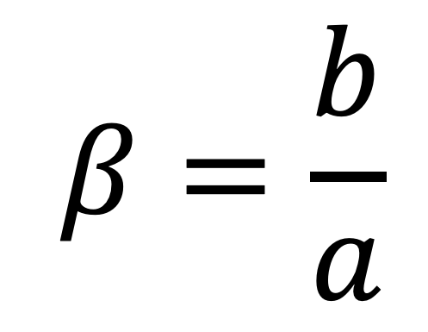
Resource unit cost ratio (β)
cost of acquiring and using N
$$β=\frac{b}{a}$$
cost of acquiring and using H₂O

Slide 49
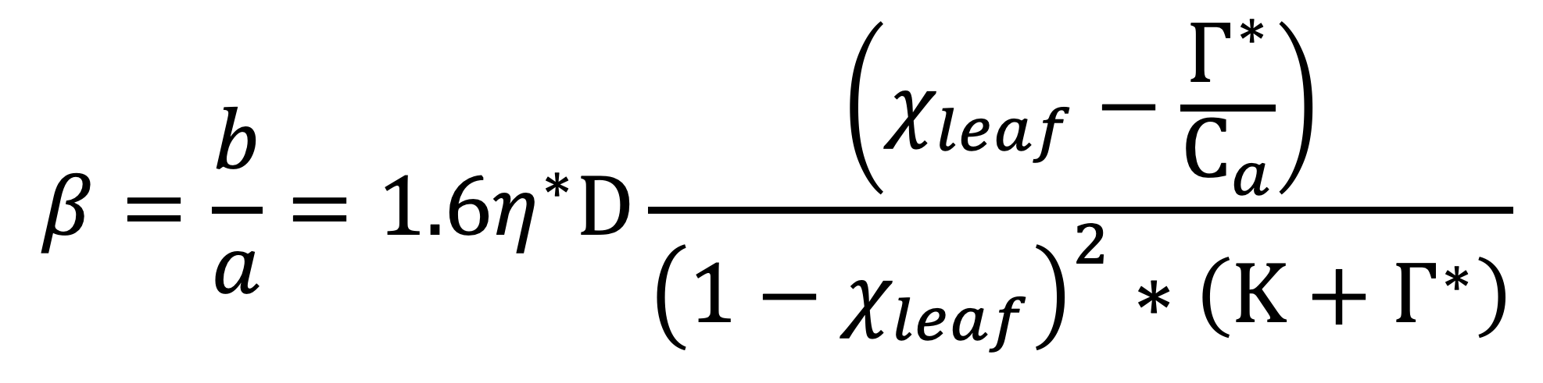
Resource unit cost ratio (β)
$$β=\frac{b}{a}=1.6η^{∗}D\frac{\left(χ_{leaf}−\frac{Γ^{∗}}{C_{a}}\right)}{{\left(1−χ_{leaf}\right)}^{2}∗\left(Κ+Γ^{∗}\right)}$$
Notes:
We used the following field manipulation experiment to investigate whether changes in soil resource availability influenced leaf quantity/quality tradeoffs or water/nitrogen use tradeoffs.
Starting in 2010, our coauthor Christy Goodale set up a full-factorial nitrogen-by-sulfur field manipulation experiment at three sites in a contiguous closed canopy forest all within a 20-km radius of Ithaca, New York
This experiment was originally created to tease apart the impacts of soil pH change and soil nitrogen fertilization on forest ecosystem functions;
however, because sulfur additions acidify the soil and promote nitrogen losses over time, this system provides a unique soil nitrogen availability gradient to test our hypotheses

